Slide 1

SAP BTP ABAP on Cloud / RAP Training
DAY-8
Anubhav Oberoy
www.AnubhavTrainings.com
Follow excellence with sheer passion

Slide 2


DISCLAIMER
The training content and delivery of this presentation is confidential, and cannot be recorded, or copied and distributed to any third party, without the written consent of Anubhav Trainings

Slide 3

01
Introduction to Fiori
02
Introduction to Tools & Terms
Build, Package and Deploy in BTP
03
Git to manage source code
04
Notes:
https://pixabay.com/photos/san-francisco-transamerica-pyramid-1633203/

Slide 4

Development Flow – Processor and Approver
Fiori App – Processor
Create, update, delete, copy travel
Fiori App – Approver
Display the travel request data
Service definition
Service Binding
Service definition
Service Binding
MDE for Processor Projection
MDE for approver Projection
BDEF Projection
For Processor
Expose what is needed by a processor role in company
Behaviour Definition (BDEF)
Tell RAP framework regarding our operations which needs to be supported for BO (managed)
BDEF Projection
For Approver
Expose what is needed by a approver role in company
Business Object Projection
For Processor
30 fields to internet
Business Object (definition)
Includes the Travel, Booking and Booking Supplement CDS entities
100 fields
Business Object Projection
For Approver
25 fields
www.anubhavtrainings.com

Slide 5
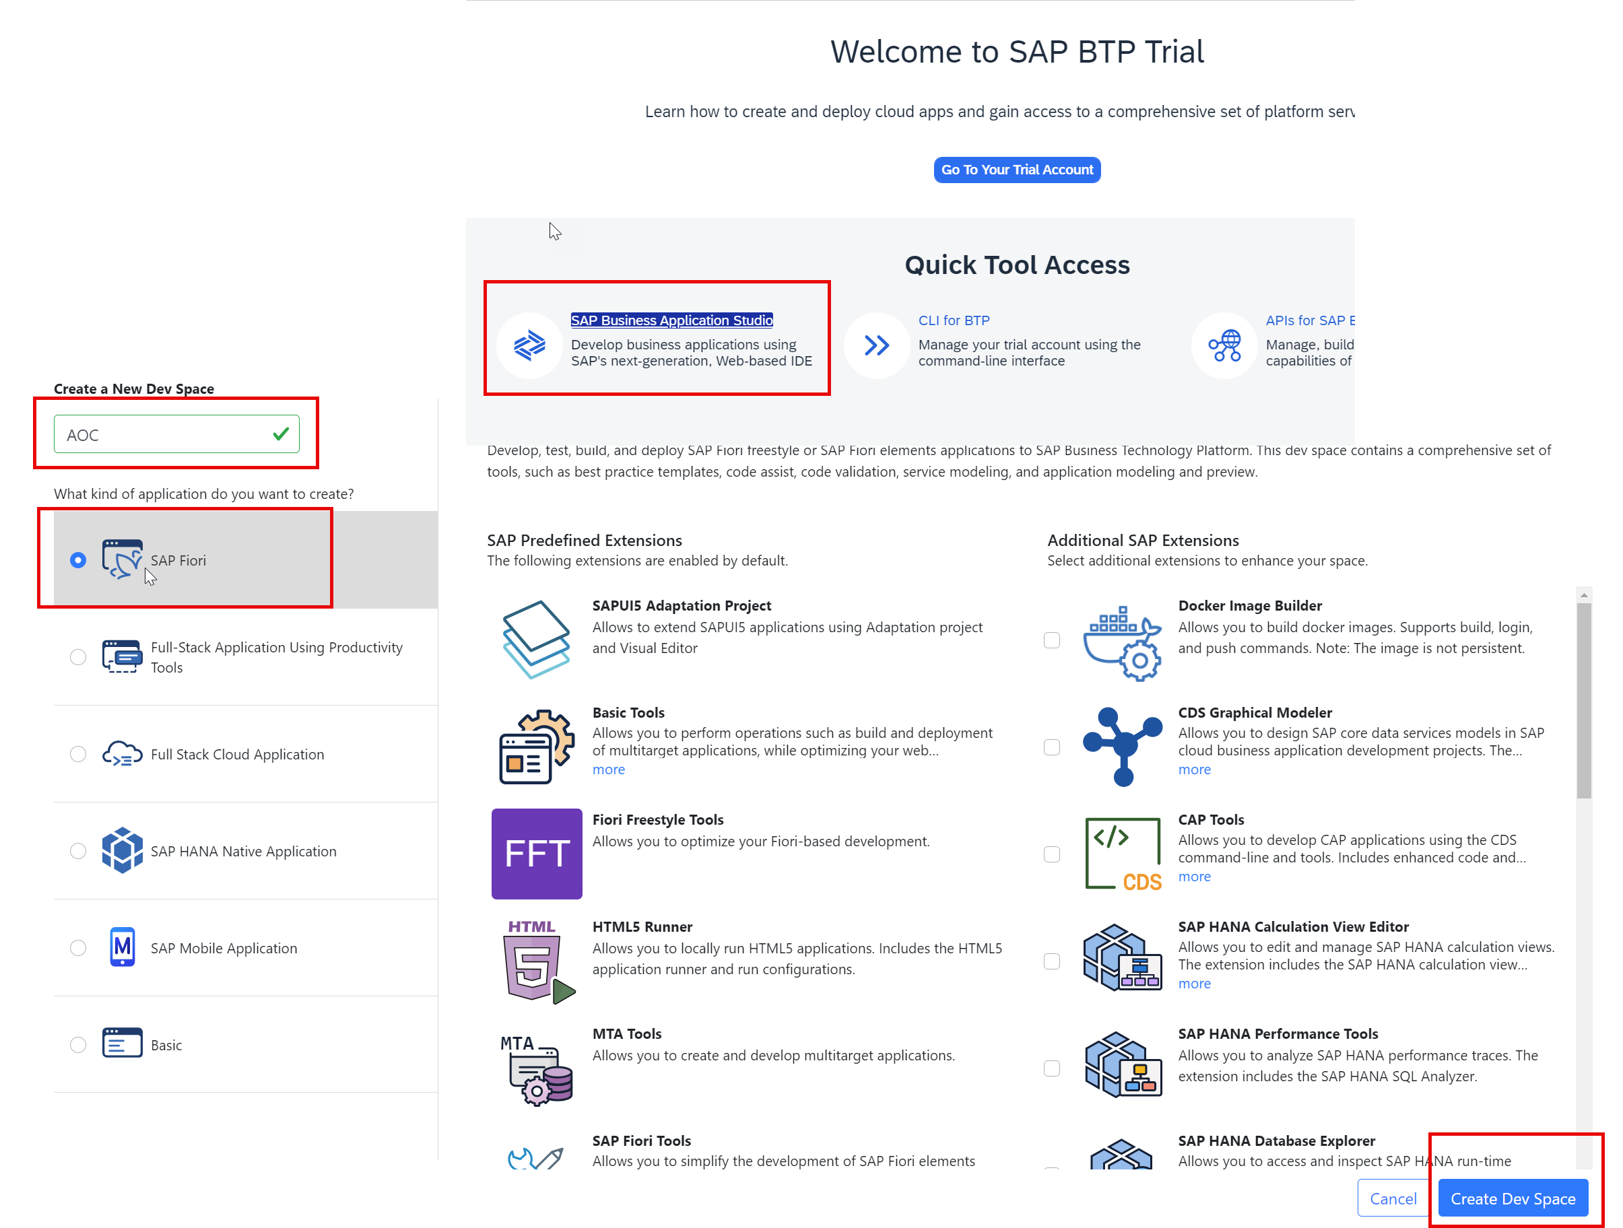
Business Application Studio
SAP Business Application Studio is a development environment available on SAP Business Technology Platform. It is a multi-cloud development tool to build wide verity of SAP applications in cloud. It offers the pre-configured development environment for developers.

Slide 6
Dev Space in BAS
We don’t want a single developer to consume all the available resources
We want a clear isolation of one developer with another
Pre-configured by sap for specific development
Solution - Virtualize
Dev Space
Dev Space
Dev Space
SAP BAS – Business App Studio
SAP BTP – Platform as a Service
IaaS – Infrastructure as a Service

Slide 7
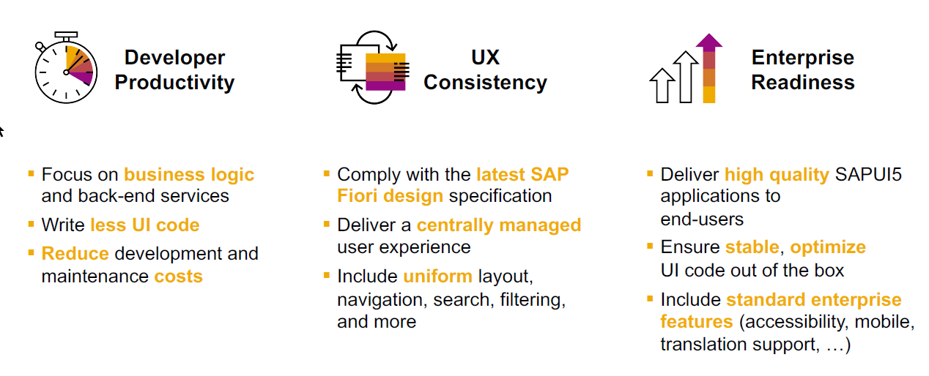
SAP Fiori elements boosts SAP Fiori development efficiency

Slide 8
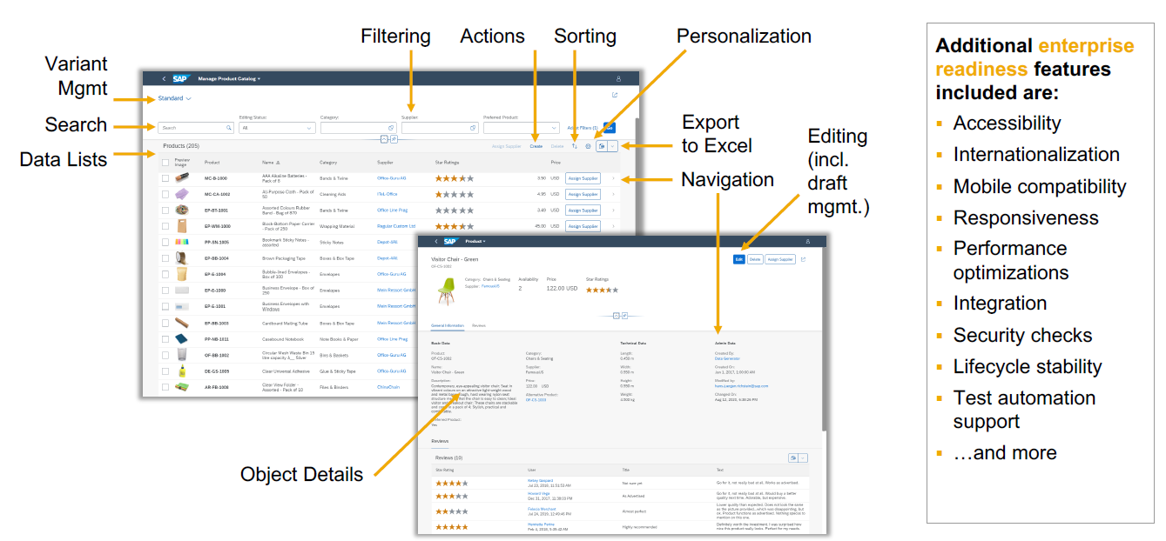
SAP Fiori elements provides enterprise-ready apps out of the box

Slide 9
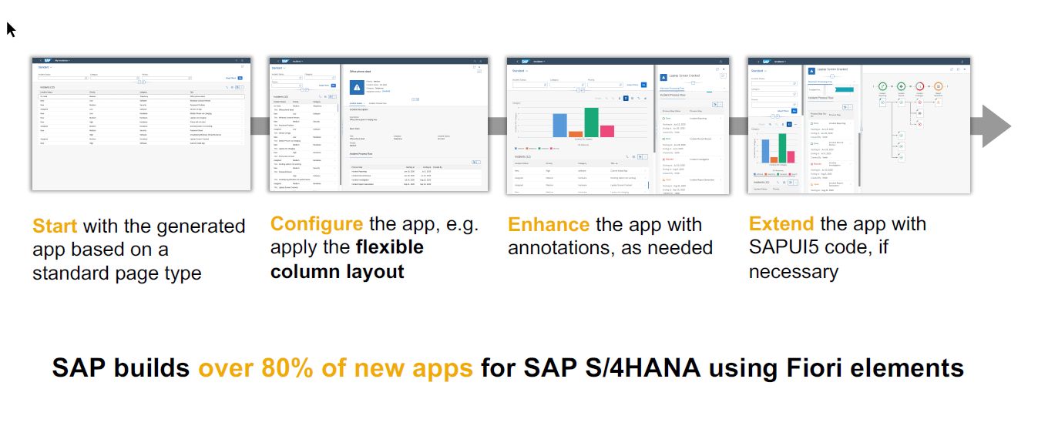
SAP Fiori elements application architecture provides flexibility

Slide 10

SAP Fiori elements prioritizes efficiency over flexibility

Slide 11
Question
Currently you are testing the Fiori App by using the standard preview option in eclipse tool. Will our end user have the ability and skill to open eclipse tool, go to package and search BIMP and then open preview and that too in production system.
Business Application Studio – It is a multi cloud development tool which allows developers to build, test, package, deploy, and manage end to end Fiori applications.
SAP build work zone (aka cFLP in BTP) – it helps us to configure a site called Fiori launchpad in the cloud. All the Fiori Apps which you build in BTP will be accessed via this build workzone from end user. End user will get single URL, which contains the tiles for all our apps deployed in BTP.
Continuous Integration Service – When a developer change the application, and push to central repository like git, the CI service will automatically build and deploy our app.
Note:
All the Fiori apps which we create in BTP will be called MTA – Multi target application, they are deployed with mta.yml file. Which will contain the configuration for the Fiori App.
In SAP BTP, there is a storage space called html-5-repository where the BTP will store our Fiori apps.
When we deploy our app, there is html5-deployer which will take our app from BAS tool and deployes it to the HTML5 Repository (Design time)
When we run the app, there is a service called html5-rt (runtime) service which will load our app from the repository in the build workzone.
Apart from that the application will contain a connectivity service to communicate with our abap on cloud system.
And a destination service which will read the destination (RFC) of AOC system to access data in Fiori.
www.anubhavtrainings.com

Slide 12






















Slide 13
































Slide 14
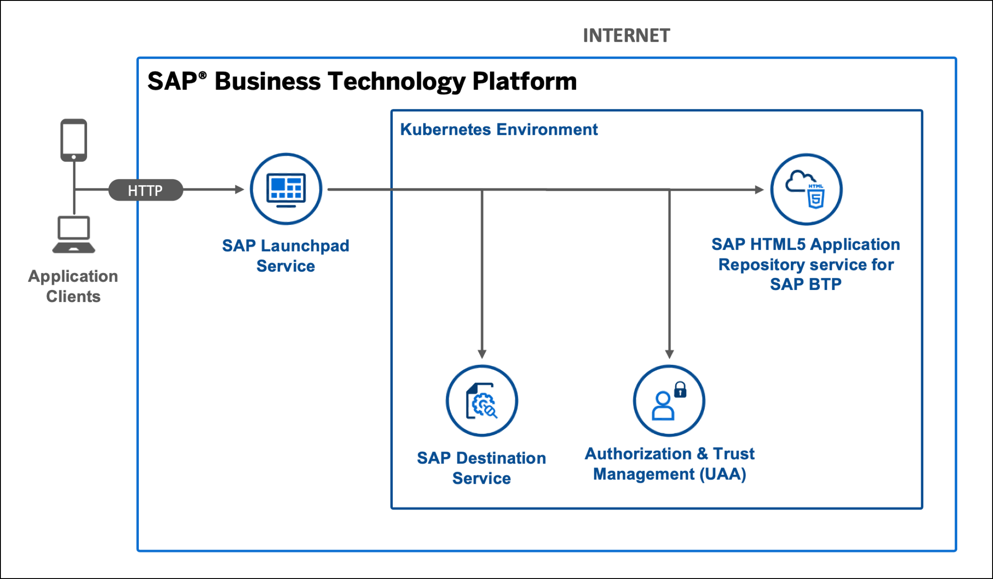
Hands on Serverless SAP Fiori Extension App

Slide 15
Title
{
"xsappname": "comatstproctravelprocessorapp",
"tenant-mode": "dedicated",
"description": "Security profile of called application",
"scopes": [],
"role-templates": [],
"oauth2-configuration": {
"token-validity": 60000,
"refresh-token-validity": 2592000,
"redirect-uris": [
"https://*.cfapps.us10-001.hana.ondemand.com/login/callback"
]
}
}
www.anubhavtrainings.com

Slide 16














































Slide 17
How did Anubhav build and deploy fiori
Create the Dev space in BAS tool
Open the bas tool and open folder to choose projects folder
We have to open terminal and login to btp a/c cf login -a https://api.cf.us10-001.hana.ondemand.com --sso
Press F1 and choose open application generator to generate Fiori app of template: List Report Template
Select the system as AOC and choose our service binding name for processor
Provide app details, deployment details (btp), launchpad details and create app
Right click on mta.yml and build MTA archieve
Choose F1, open application info and select deploy
Assign the roles of our Launchpad service to our user
Open SAP Build workzone and create a site with name mylaunchpad
Go to channel manager and refresh the apps which are stored in html5-repository
Go to content manager and choose content explorer and pull the app
Create a catalog and a group and add our app to them
Go to everyone role and assign the app to the role
Open the site to test our app
Repeat the same steps if there is a change in the app.
We need to create a git repository and push our app code (backup)
Register a web hook and use the same in CI CD service so that the application will deploy automatically to BTP cloud
www.anubhavtrainings.com

Slide 18
Git and ABAP on git
Git is a source code repository management system, git hub is a repository on internet. We interact with github using git software. If I want to take a backup of all our code which we created in AOC system, git is a great choice. This way we can also export import our code between cloud and on-premise system.
For cloud system, we use git plugin in eclipse which is provided by SAP. The installation was covered in 3rd session.
Steps:
We need to add the plugin for abap git in ADT - http://eclipse.abapgit.org/updatesite/
Create a github account and add a PAT token under developer setting
Create a repository in git hub
Click on Add to link a repository and paste url from step 3
www.anubhavtrainings.com

Slide 19
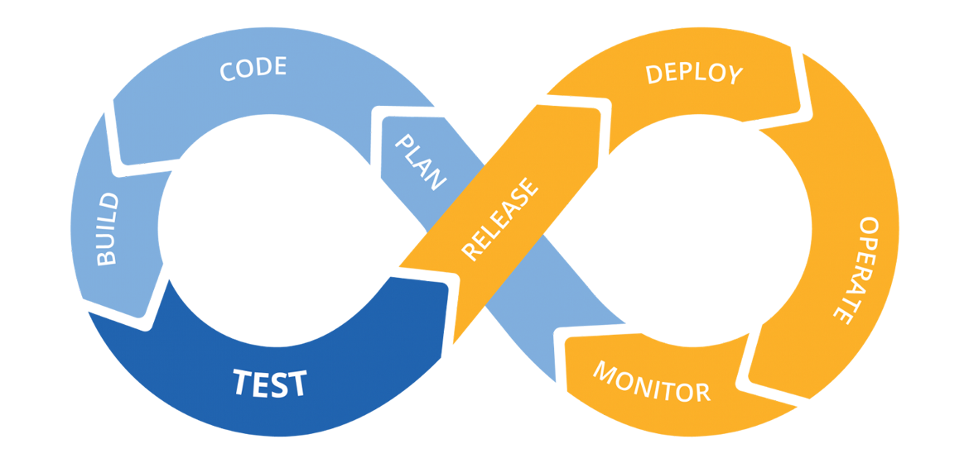
Hands on: Continuous Integration

Slide 20
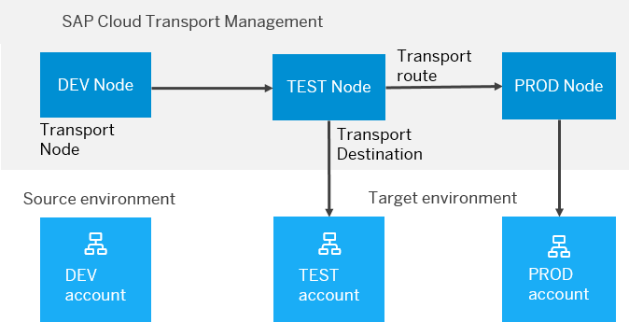
BTP Cloud Transport Management
SAP Cloud Transport Management service lets you manage software deliverables between accounts of different environments (such as Neo and Cloud Foundry), by transporting them across various runtimes. This includes application artifacts as well as their respective application-specific content.
SAP Cloud Transport Management service adds transparency to the audit trail of changes so that you get information about who performed which changes in your production environment, and when they did it. At the same time, the service enables a separation of concerns: For example, a developer of an application or of SAP Cloud content artifacts can trigger the transport of changes in a development subaccount, while the resulting import into the test, and production subaccount is handled by a central operations team.

Slide 21

Hands on SAP BTP Cloud Transport

Slide 22
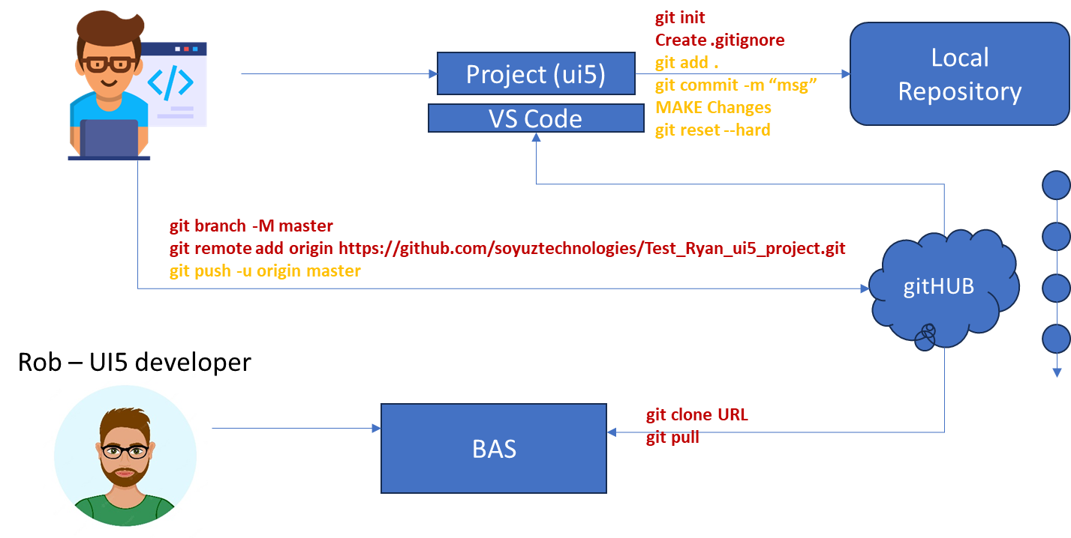
Git and Git HUB

Slide 23
Reference Scenario – Unmanaged Impl.
Imagine in our company we had written all the business logic in the past ourself in form of FM, Classes. Today we want to reuse our old code which has the business logic, validation, sequence, processing, along with transaction buffer. So if you want to manage all these codes yourself and integrate your legacy (old code written by you or your team), you will opt for unmanaged (here RAP is not managing the CURD operation) scenario.
SAP is providing a demo class for learning purpose viz. /dmo/cl_flight_legacy
In this class we have our own old logic which contains the transaction buffer and business logic to maintain all the source code to interact with database ourself.
The RAP framework allows us to implement the entire runtime of the BO
Interaction Phase (code to interact and keep data inside itab)
Transaction Buffer (like a internal table where we keep temporary data)
Save Sequence (Commit work and Rollback)
UPDATE_BAPI
(LUW)
BAPI_TR_COMMIT
BAPI_TR_ROLLBACK
www.anubhavtrainings.com

Slide 24
Development Flow
Serv Impl.
BIMP-unmanaged
Serv definition
BDEF - unmanaged
Travel_U
Travel_U_MDE
Agency
Customer
agency
customer
/dmo/travel
www.anubhavtrainings.com

Slide 25
Title
<>
How you know in the code which fields are changed on the screen by the user.
So accordingly we can update the data into the database only for the changed fields??
RAP provides a compiler structure called %control which will tell us what fields were changed on UI.
We need to tell the RAP, what will be the datatype for the control structure.
*
*
*
www.anubhavtrainings.com

Slide 26
Attachments
Starring SAP ABAP on Cloud release 2208 SAP started direct support for attachments (PDF, Excel, Images, TXT, Word) including binary files. We must need to create a database table with atleast following columns
Attachment (Data type: RAWSTRING length 0)
Mimetype (Document type, String128)
Filename (Document Name, String128)
Travel
Attachments
1 n
www.anubhavtrainings.com

Slide 27
Steps
Create new attachment table according to need and design
Create a Interface Entity for the attachment table and mark our attachment field with special attachment annotation, So the RAP framework can treat it as an attachment accordingly.
Add annotations for admin fields, and user labels.
Create composition of our attachment table with travel entity like we had the composition of booking with travel entity.
Create a projection view for attachment
Relationship between Travel processor view with attachment processor view entity
Enhance the BDEF with attachment like booking
Also expose the attachment functionality with draft to processor in behavior projection for processor
Expose the entity of attachment processor in service definition
Republish the OData V4 binding
Add the metadata extension for attachment scenario and link a new facet in travel for attachment table
Testing
www.anubhavtrainings.com

Slide 28
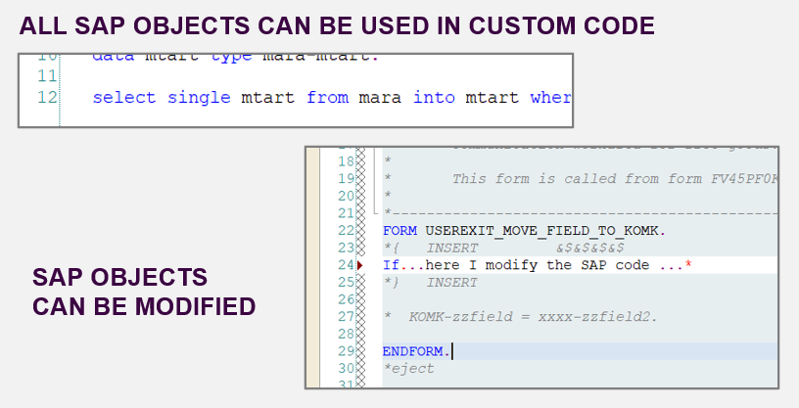
From classic ABAP extensions to ABAP Cloud development
<>
www.anubhavtrainings.com

Slide 29
What is ABAP Cloud Development Means:
Use public SAP APIs (local or remote) released by SAP to access SAP functionality and SAP data
Use public SAP extension points released by SAP to extend SAP objects. Modifications to SAP standard objects are not supported (applies to S/4HANA Cloud system)
Use of Adt (ABAP development tools) on eclipse
Use Steampunk (RAP – Restful Application Programming model) to build Fiori Applications and services. SAP technologies like Dynpro and webdynpro are not released for cloud development.
www.anubhavtrainings.com

Slide 30
What is Embedded Steampunk
If we are using SAP BTP to develop side by side extensions, full stack SAP applications in BTP (Steampunk)
If we are using In-app Developer extensibility with released objects in S/4HANA (all editions) with RAP (Embedded Steampunk)
If you using RAP and enhancing your Standard SAP Applications delivered by SAP in S/4HANA system, the recommended approach is Embedded Steampunk.
Every Customer using S/4HANA can decide whether they want to use new approach (embedded Steampunk) or classic extension approach (BADI) @ Object level
This can be done by switching a setting @ object level.
www.anubhavtrainings.com

Slide 31
www.anubhavtrainings.com
Thank You
End of Day 8
www.anubhavtrainings.com

Slide 32


We’re committed to empower you to be
#FutureReady
through powerful training solutions.
We build the workforce of the future.
250+
Corporate Clients
30,000+
Learners Trained
25000+
Learners Placed
FREE WEBINARS
Sign up for free webinars with industry experts every fortnight!
Enroll Now!
Contact us today!
https://anubhavtrainings.com

